Slide 1
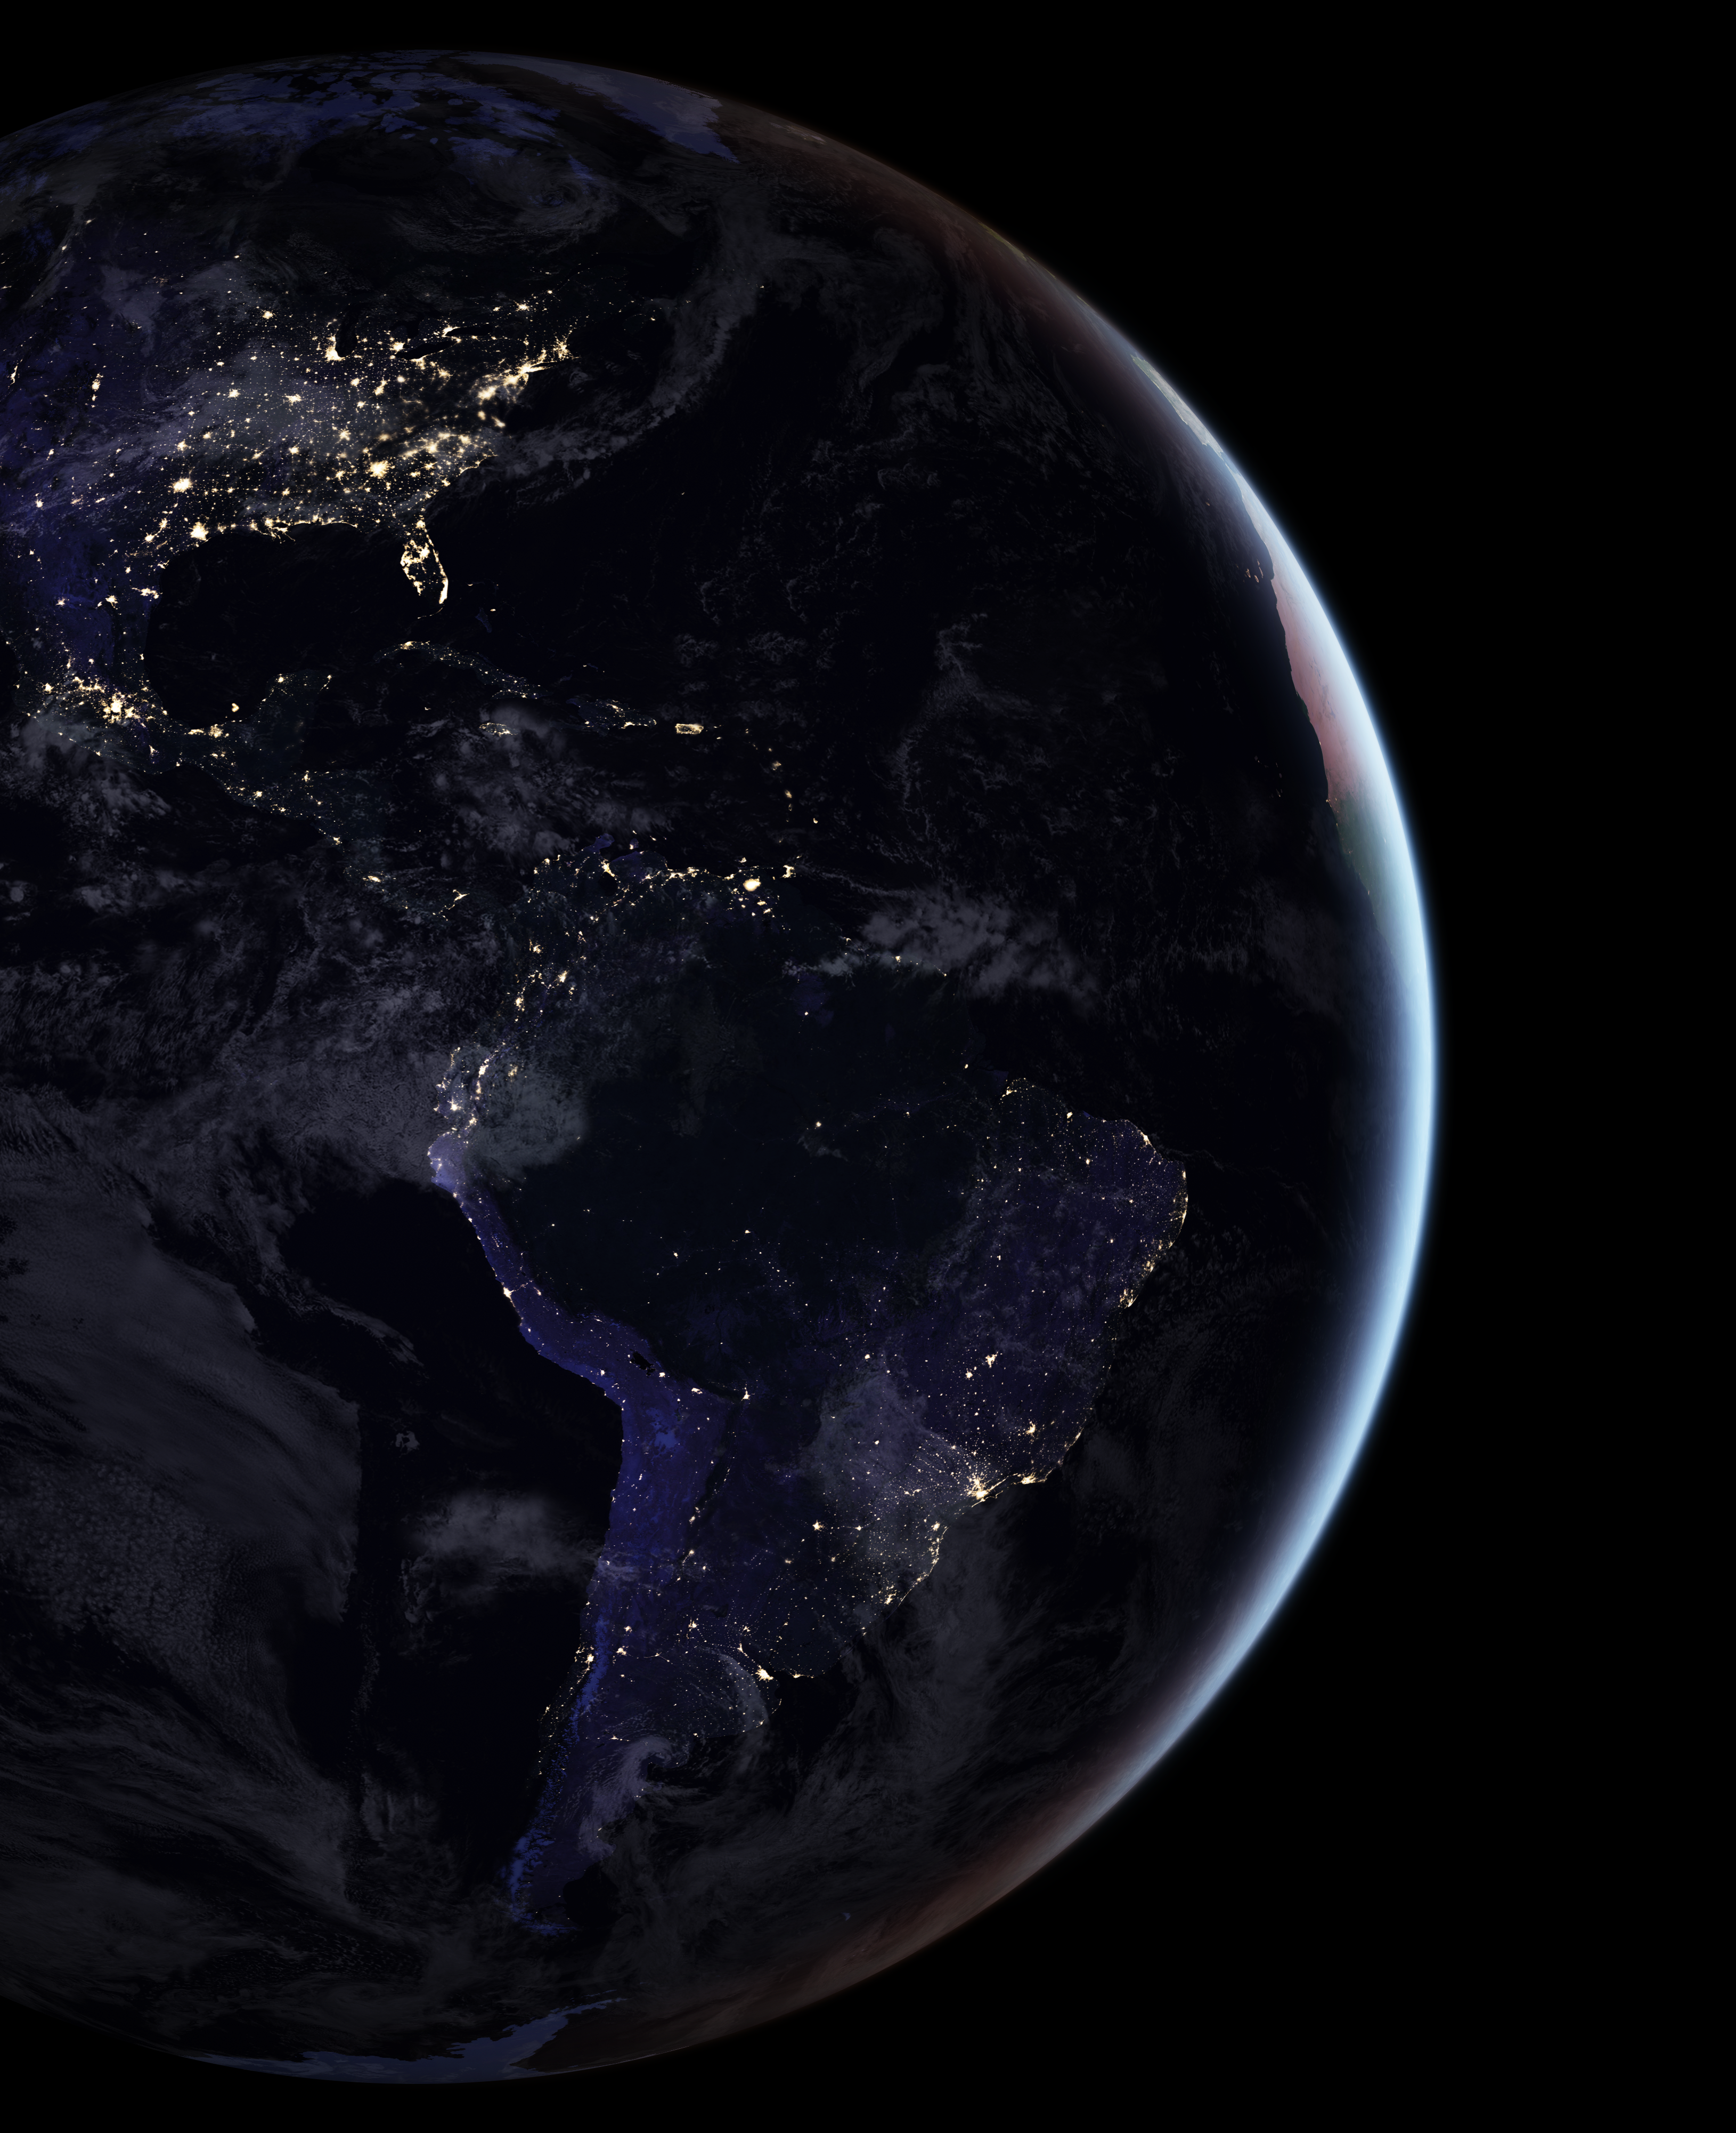
ALAN
Silent killer of the night
Cassandra Hui
Valentina Alaasam
Data Science for Biology II - Spring 2022
Notes:
If you’re confused or curious about anything please pipe in! or write questions in the chat for me to answer at the end!
I’m going to start really broad talk about patterns we are seeing at a global scale and how whole ecosystems are responding
Then end really specific and talk about what light pollution is doing to individual birds (which is what I study!)

Slide 2
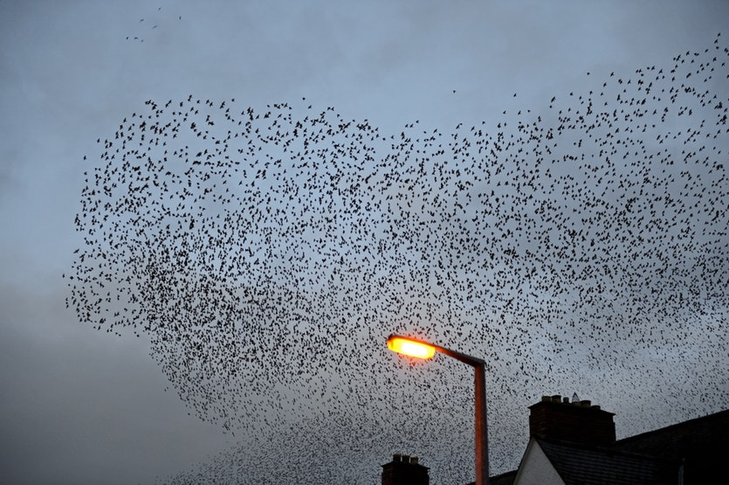
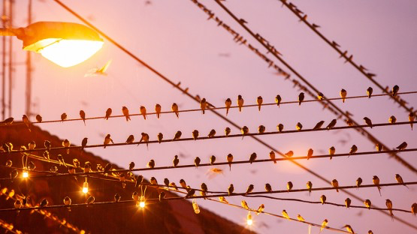


Slide 3

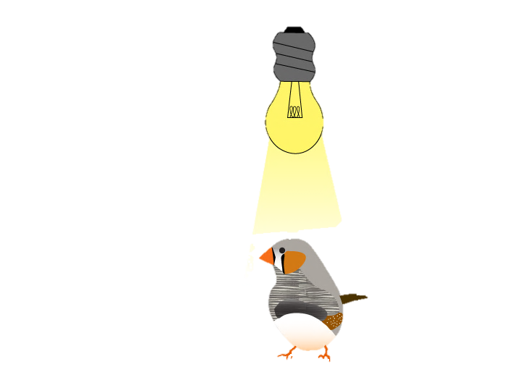


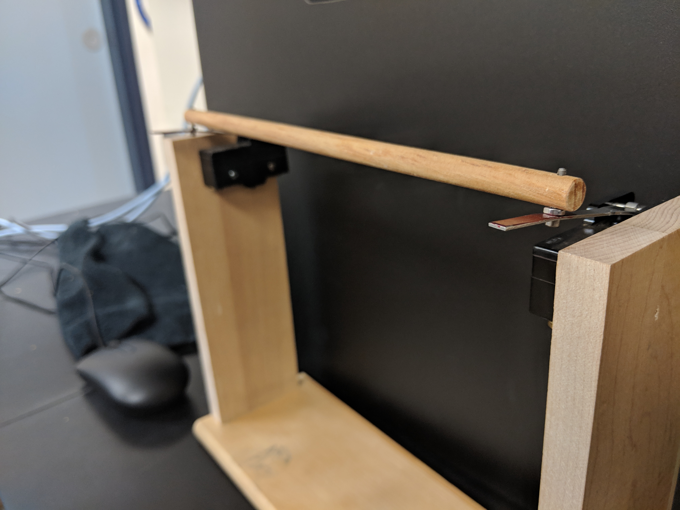

Behavioral Responses Sleep / Activity

Slide 4




Behavioral Responses Sleep / Activity

Slide 5
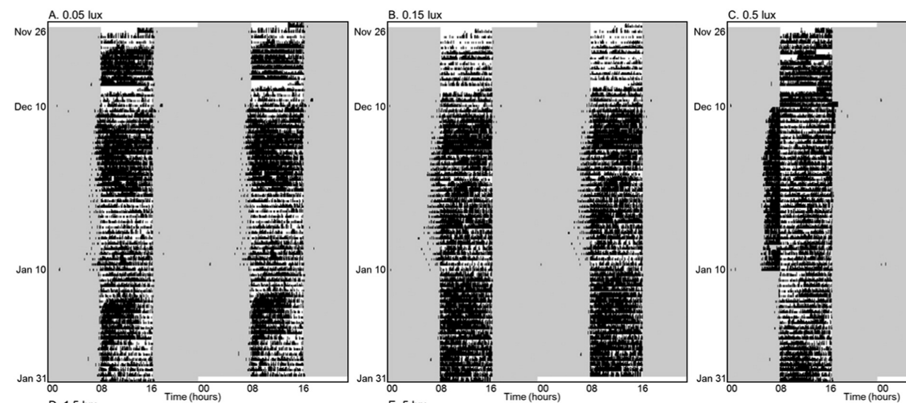
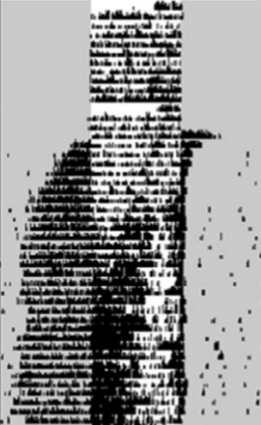
Behavioral Responses Circadian Rhythm

Slide 6
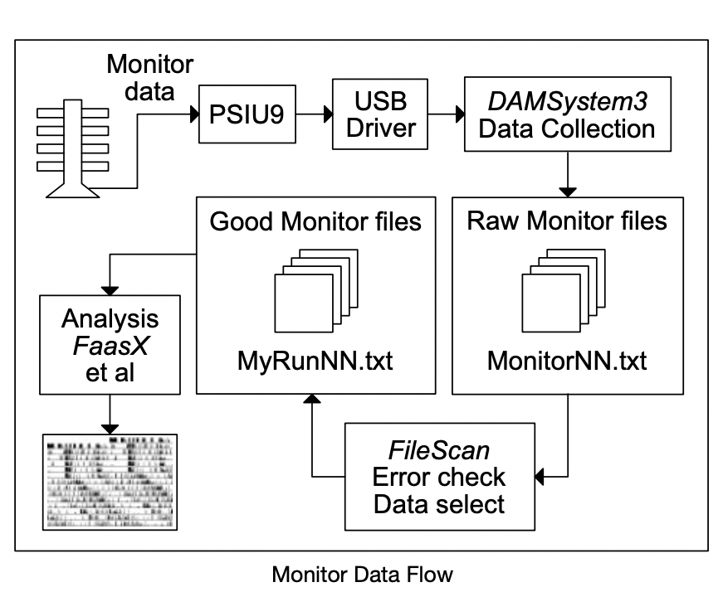

Drosophila Activity Monitor (DAMSystem)
Behavioral Responses Circadian Rhythm
Fly Activity Analysis (FaasX)

Slide 7
Behavioral Responses Circadian Rhythm
Clock
Cry1
Bmal1
Per2
Per3
Brain
Liver
Zeitgeber Time
ALAN Control
Notes:
And we found no change in the oscillation of circadian gene expression. Apologies for how busy this slide is, this is 5 circadian clock genes and expression levels in the brain, as well as the liver
And the main take away is that there was no shift in the rhythm or amplitude of expression for any of the genes

Slide 8
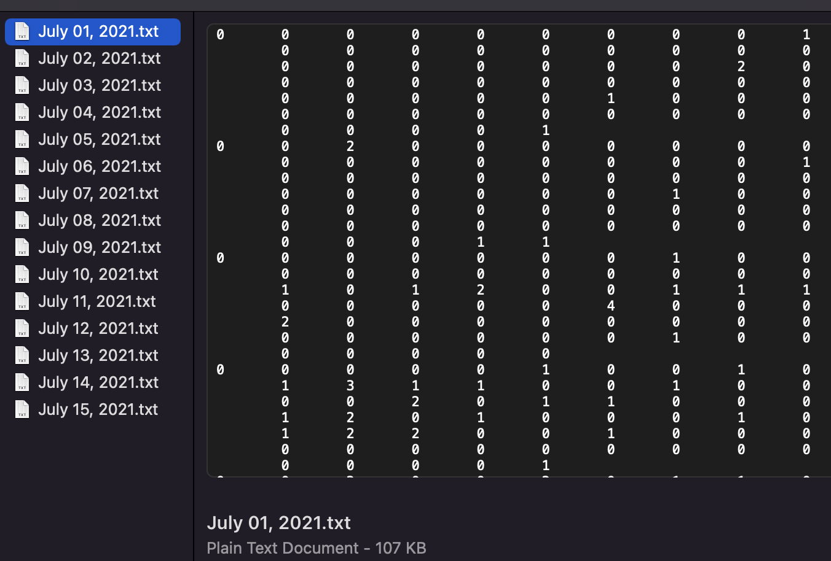



Slide 9
Project Aims:
Write a script - streamline a process for processing, cleaning up, and reorganizing data!
Collaborate on Git Hub!
Visualize our data!

Slide 10
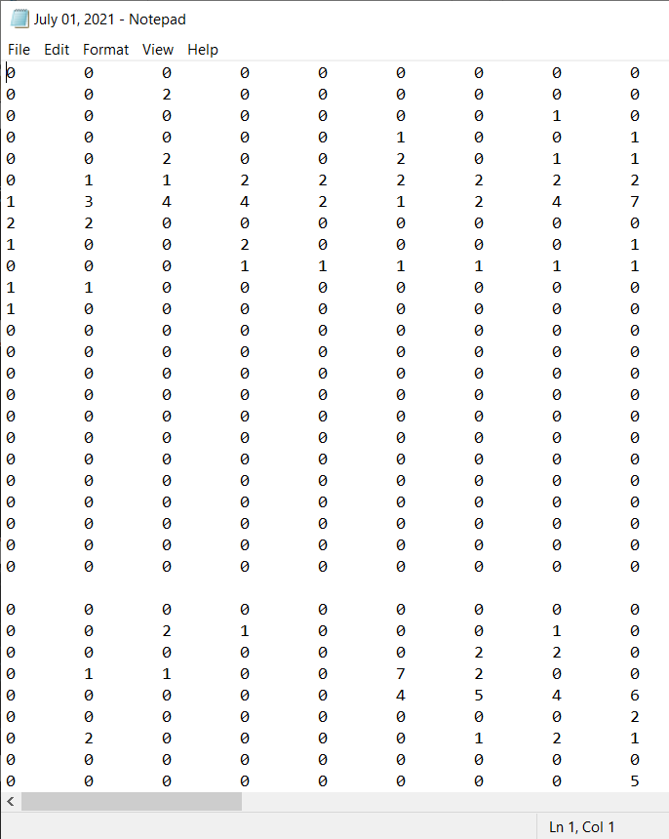
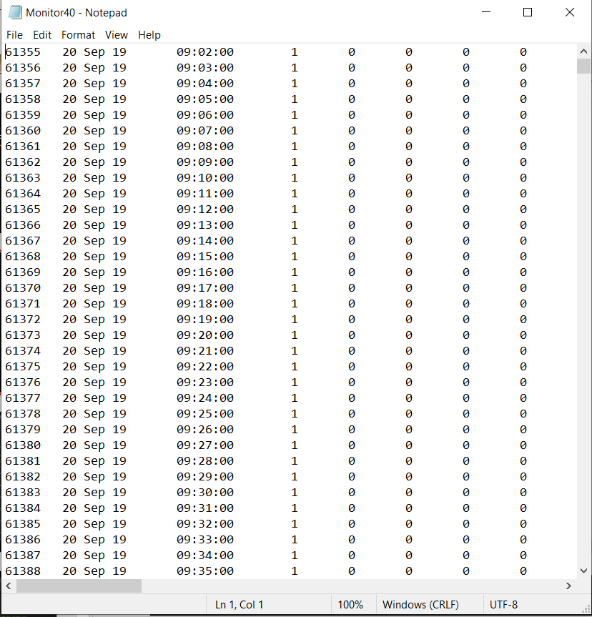
Cassandra

Slide 11
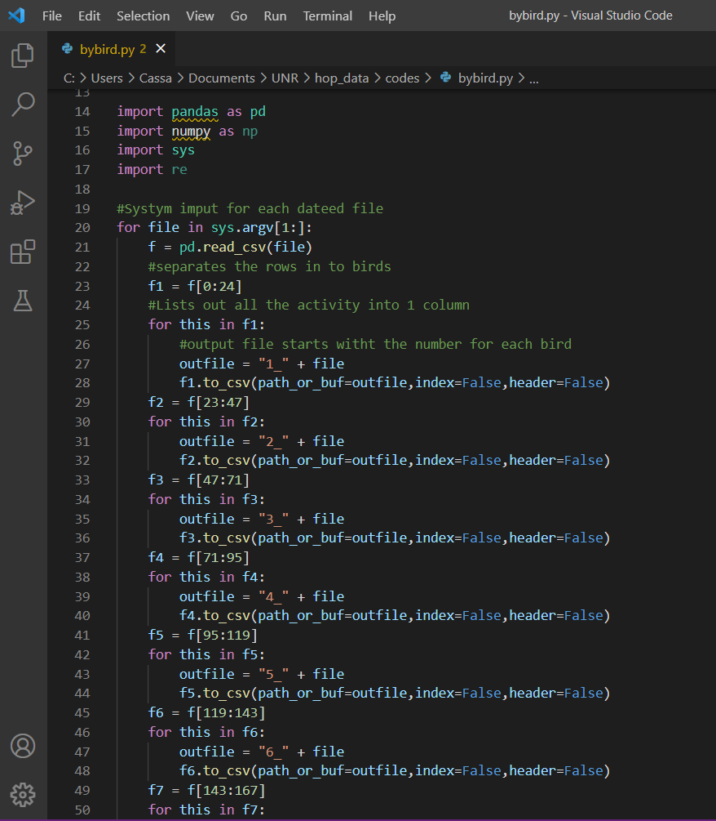
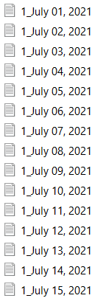
Cassandra
Separate each date into individual birds by date.
python bybird.py July*

Slide 12
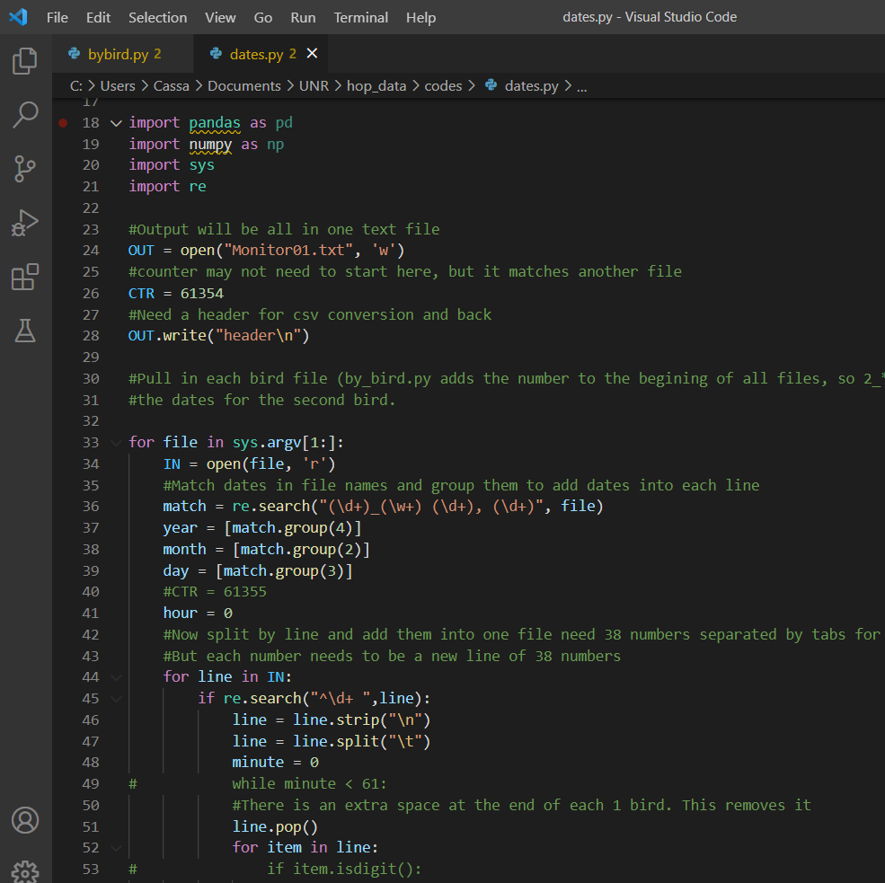
Cassandra
python dates.py 1_July*

Slide 13
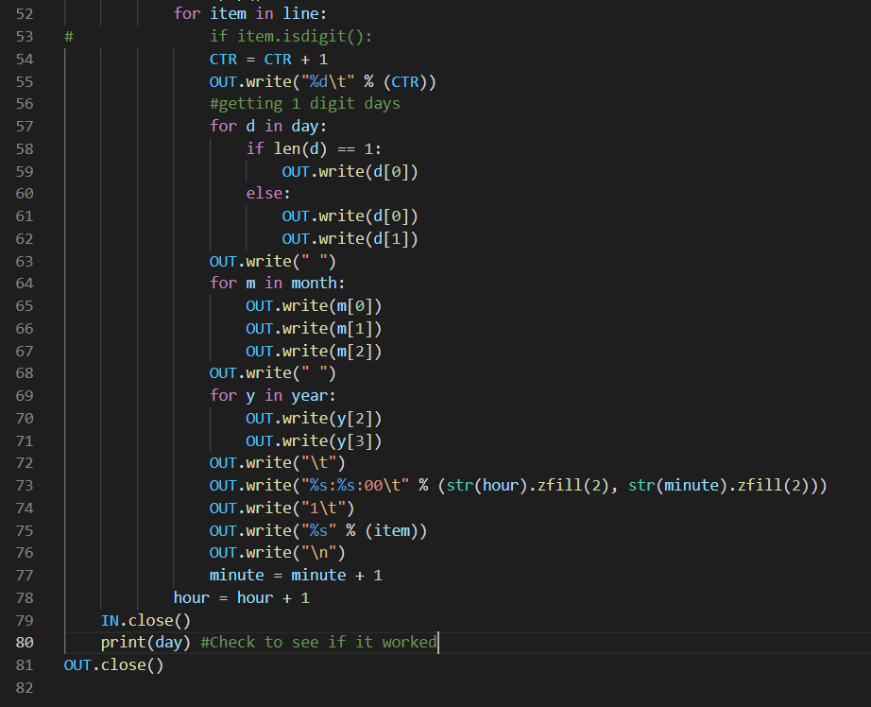
Cassandra

Slide 14
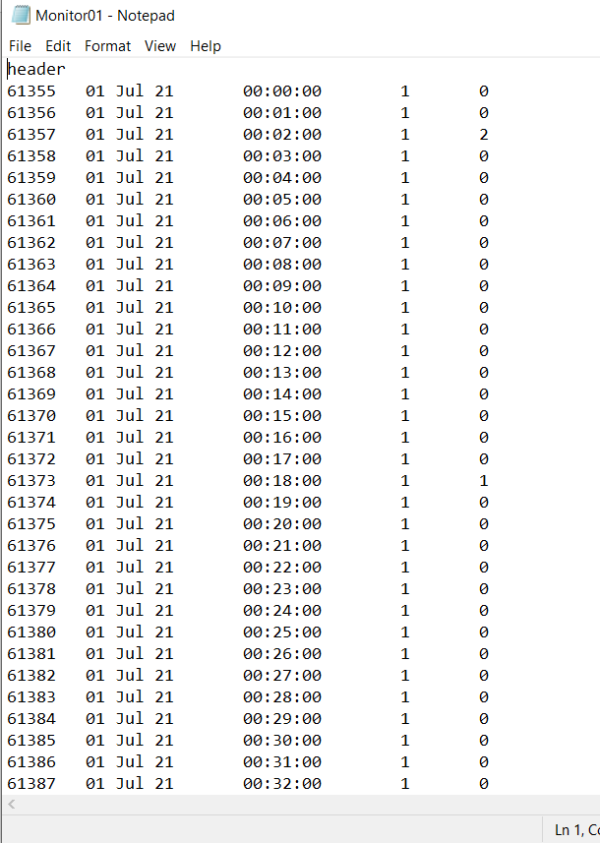
Cassandra
Then run another python code on the rest of the birds to add them into one file.
python rest_birds_dates.py b2.txt 2_July*
python rest_birds_dates.py b3.txt 3_July*
python rest_birds_dates.py b4.txt 4_July*
...
Then run through a Jupyter notebook that convers to csv and adds in all the other birds as columns.

Slide 15
Cassandra
#Open csv and remove header and 1st row
python csv_to_txt.py Monitor02.csv
#To clean file
#In terminal run the following
tr -d '\ \"' <Monitor02.txt> Monitor03.txt
#removes quotes
sed -i 's/Jul/\ Jul\ /g' Monitor03.txt
#Add spaces around all the dates in the file
sed -i 's/\t$//g' Monitor03.txt
#Removed tab at the end of each line

Slide 16
Cassandra
#Need to fix script to only use one digit days, this replaces
sed -i 's/01\ Jul/1\ Jul/g' Monitor03.txt
sed -i 's/02\ Jul/2\ Jul/g' Monitor03.txt
sed -i 's/03\ Jul/3\ Jul/g' Monitor03.txt
sed -i 's/04\ Jul/4\ Jul/g' Monitor03.txt
sed -i 's/05\ Jul/5\ Jul/g' Monitor03.txt
sed -i 's/06\ Jul/6\ Jul/g' Monitor03.txt
sed -i 's/07\ Jul/7\ Jul/g' Monitor03.txt
sed -i 's/08\ Jul/8\ Jul/g' Monitor03.txt
sed -i 's/09\ Jul/9\ Jul/g' Monitor03.txt
#Rename to Monitor3.txt
#Monitor3.txt is now correct

Slide 17
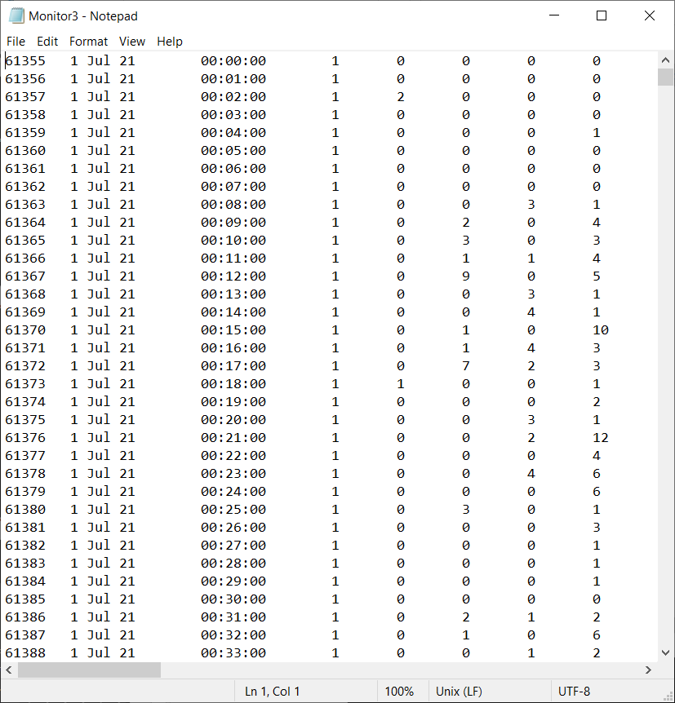
Cassandra
Final Raw Data

Slide 18
Meta-data / outline
Val
For each file...
Open file
Designate rows to 24 hours
Designate rows to 24 birds
Transform data longwise
(i.e. create "Hour" and "Minute" columns)
Create binomial (0/1) for activity per minute
Add phase (night/day) depending on hour
Add a date - pulling date from original file name but transforming it into a 'good' date
Separate date into 3 columns (year, month, day)
Save file as new file
Then...
After looping through files in folder and perform same program on all, combine all new files into one master dataset

Slide 19
Methods
Val
Python markdown tutorial:
https://github.com/valaasam/DataScience2022/blob/main/FinalProject/FinalProj_Markdown_VJA.ipynb
Some fun things:
Script prompts user to type in the source directory and create/designate an output directory
Provides counter to track progress

Slide 20
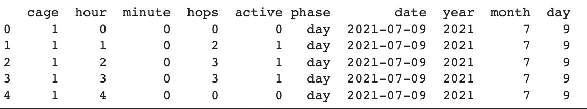
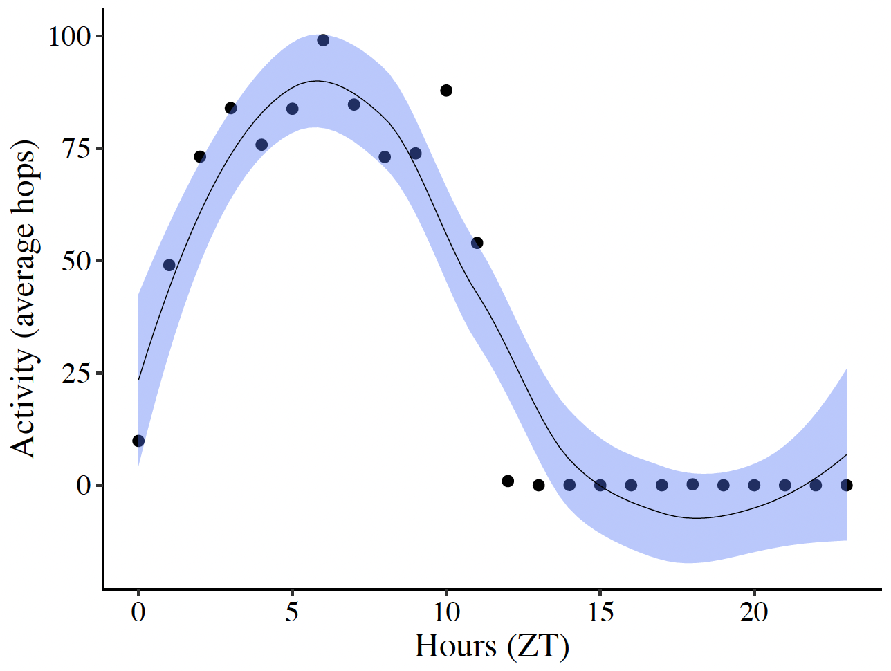
Results
Val

Slide 21
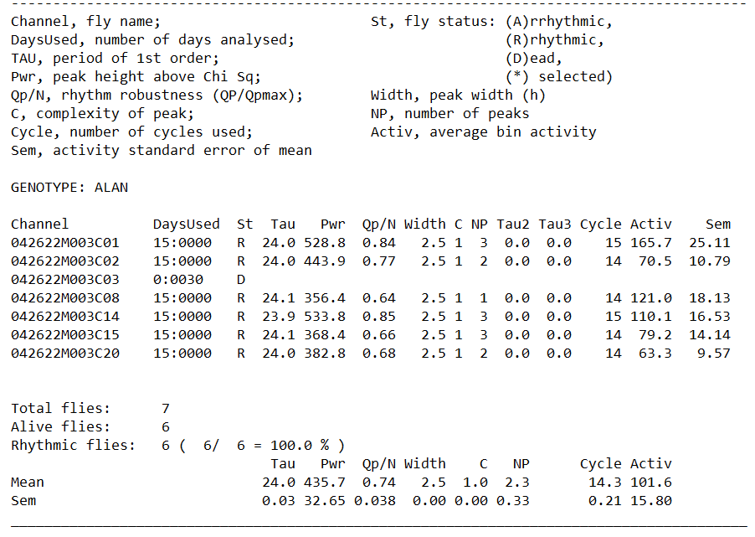
Results
Cassandra

Slide 22
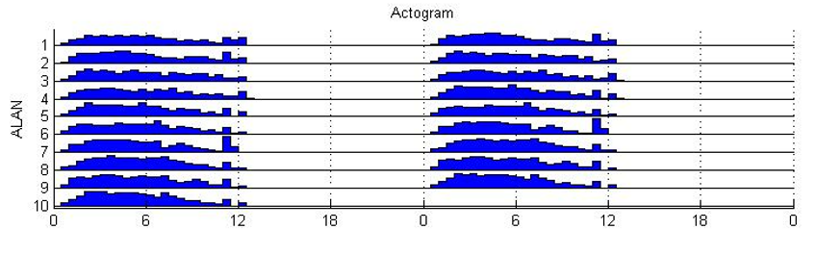
Results
Cassandra

